Slide 1
Reference Books for the slides
1) Software Engineering, ^{6th} edition
Author: Lan Sommerville
2) Software Engineering
Author: Roger S. Pressman

Slide 2
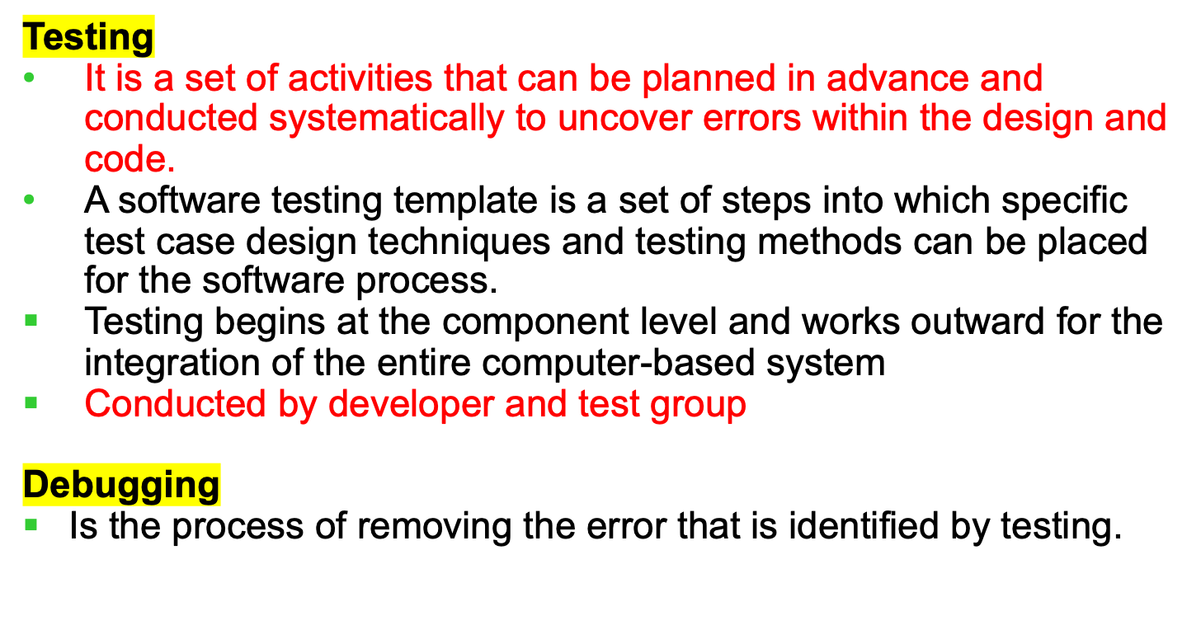
Software Testing

Slide 3
Software Testing
Types
Unit Testing
Integration “
Black box “
White box “
Alpha “
Beta “
Regression “
Basis path “
Smoke “
Loop Testing
System “
  Recovery “
  Stress “
  Security “
  Performance “

Slide 4
Unit Testing
Unit Testing
It focuses verification effort on the smallest unit of software design- software component or module
It focuses on the internal processing logic, and data structure of a component
It can be conducted in parallel for multiple components
Unit Test consideration
Unit test is shown in the following figure.
Module interface is tested to ensure that information properly flows into and out of the program unit under test
Local data structures are examined
All independent paths (basis paths) through the control structure are exercised to ensure that all statements in a module have been executed at least once
Boundary conditions are tested
Finally, all error handling paths are tested.

Slide 5
Unit Test
Interface
Local data structures
Boundary conditions
Independent paths
Error handling paths
Module
………. ……
………. ……
………. ……
………. ……
………. ……
………. ……
………. ……
………. ……
Test cases

Slide 6
Unit Test Procedure
Driver and/or stub software must be developed for each unit test
A driver is a main program that accepts test case data, passes it to the component to be tested, and prints results
A stub or dummy program uses the subordinate module interface, returns control to the module undergoing testing
Stubs replace modules that are called by the component to be tested
Drivers and stubs represent overhead
main() { Menu: a b ….. 1: a() 2: b() …… } | a() { print(“This is module a()” } b() { print(“This is module b())” }

Slide 7
Unit Test Environment
Interface
Local data structures
Boundary conditions
Independent paths
Error handling paths
Driver
Module to be tested
Test cases
Stub
Stub
RESULTS

Slide 8
Integration Testing
Integration Testing
It is a systematic technique for constructing the software architecture and conducting tests to uncover errors
It takes unit tested components and build a program structure dictated by the design
Two types i) Non-incremental integration ii) Incremental integration
Non-incremental integration
Big-Bang approach- all components are combined in advance
The entire program is tested as a whole
Incremental integration
Program is constructed and tested in small increments
Two types: i) Top-down integration ii) Bottom-up integration

Slide 9
Top-down Integration Testing
M₁
M₂
M₃
M₄
M₅
M₆
M₇
M₈

Slide 10
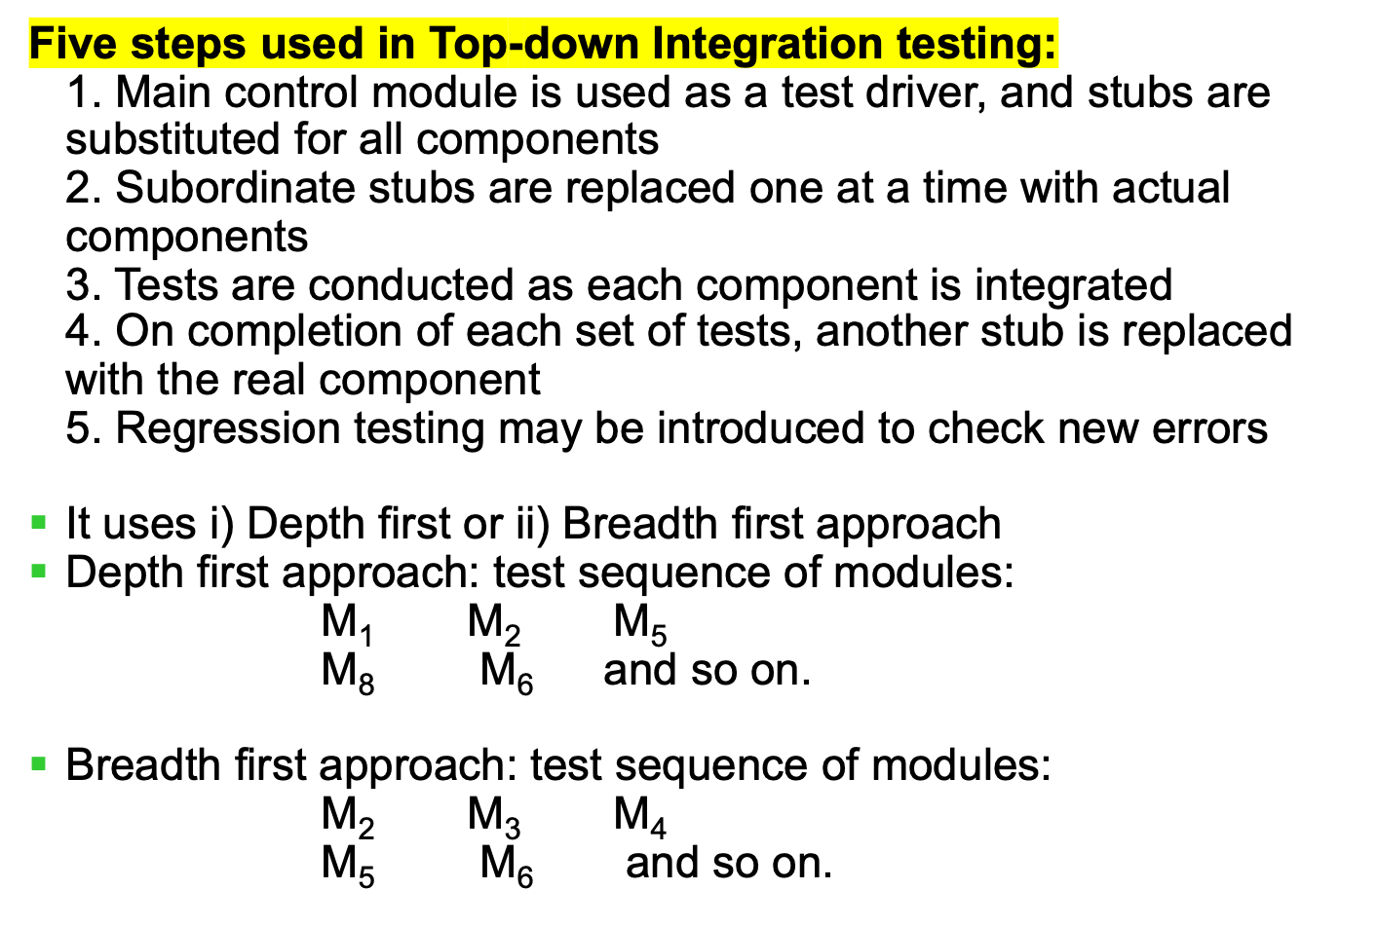
Top-down Integration Testing

Slide 11
System Testing
System Testing
It is a series of different tests whose purpose is to fully exercise the computer-based system to verify that the system elements have been properly integrated and perform allocated functions
Types
Recovery Testing
It is a system test that forces the software to fail in a variety of ways and verifies that recovery is properly performed
Stress Testing
It executes system in a manner that demand resources in abnormal quantity, frequency, or volume. It is designed to confront programs with abnormal situations.

Slide 12
System Testing
Security Testing
It verifies that protection mechanisms built into a system will, protect it from improper penetration.
Performance Testing
It is designed to test the run-time performance of software within the context of an integrated system.
Verification
It refers to the set of activities that ensure that software correctly implements a specific function
Are we building the product right?
Validation
It refers to a different set of activities that ensure that the software that has been built is traceable to customer requirements.
Are we building the right product?

